Slide 1
PRSQ-02-IMDB Movies

Slide 2
Prepared by:
Khush Panchal
Role: Data Analyst (PRSQL-01 - IMDB Movies)
Year: 2026

Slide 3
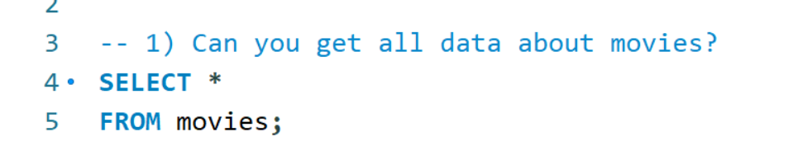
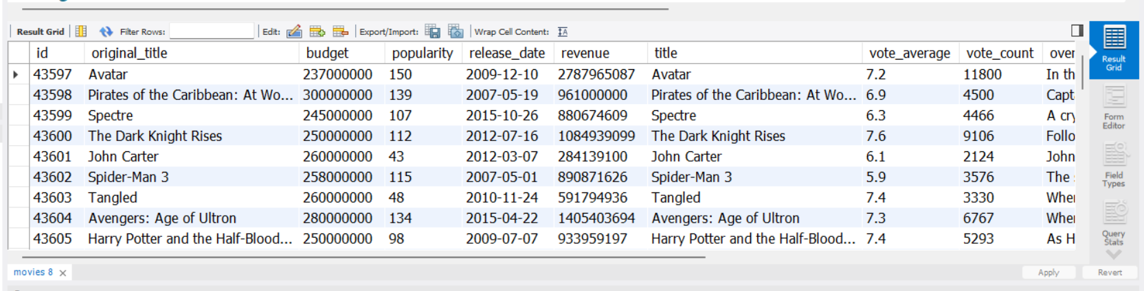
1.Can you get all data about movies?

Slide 4
1.Can you get all data about movies?
Insight:
This query retrieves complete movie-level information such as title, budget, popularity, revenue, release date, and ratings. It helps understand the overall structure and attributes of movies stored in the IMDB dataset.
Result Meaning:
You can analyze financial, popularity, and rating trends for each movie.

Slide 5
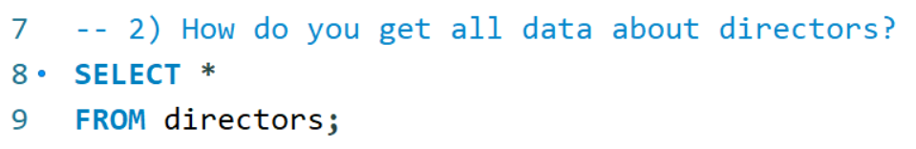
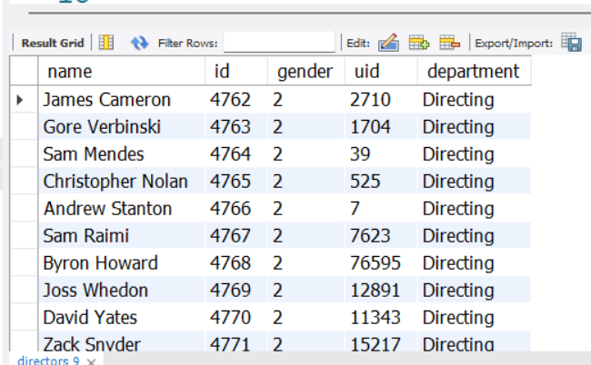
2. How do you get all data about directors?
OUTPUT:-

Slide 6
2. How do you get all data about directors?
Insight:
This query provides complete details of all directors including their names, gender, department, and unique identifiers. It helps in understanding the director demographics.
Result Meaning:
Useful for gender analysis, department-wise filtering, and mapping directors to movies.

Slide 7
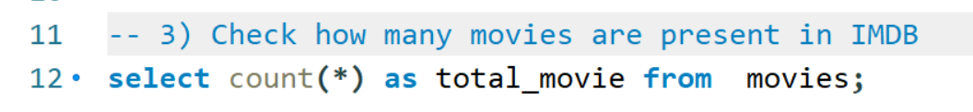
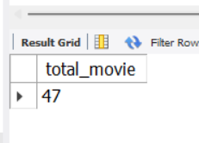
3. Check how many movies are present in IMDB.
OUTPUT:-

Slide 8
3. Check how many movies are present in IMDB
Insight:
This query counts the total number of movies available in the dataset, showing the size and coverage of the IMDB data used.
Result Meaning:
Gives an idea of dataset scale and completeness.

Slide 9
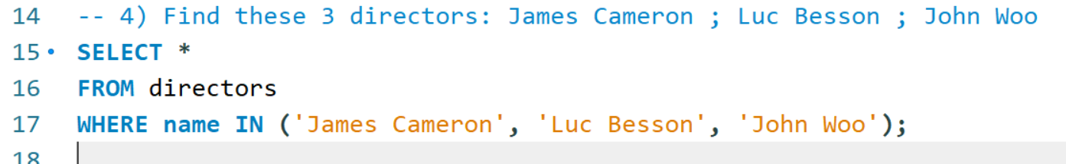
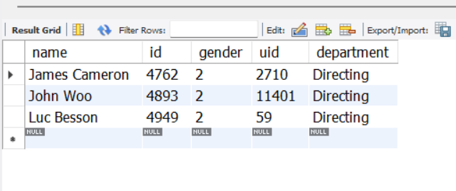
4. Find these 3 directors: James Cameron ; Luc Besson ; John Woo
OUTPUT:-

Slide 10
4. Find these 3 directors: James Cameron, Luc Besson, John Woo
Insight:
This query filters specific well-known directors to verify their presence in the dataset.
Result Meaning:
Confirms that these directors exist in the database and allows further analysis of their movies.

Slide 11
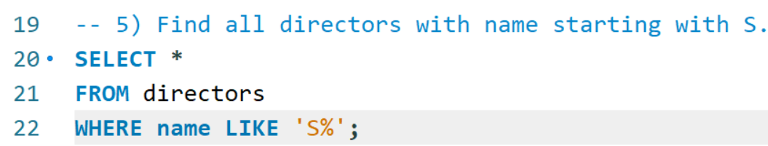
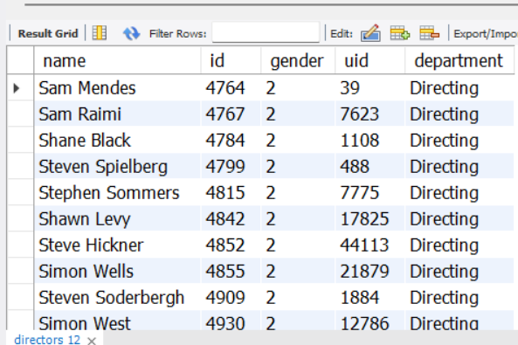
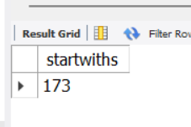
5. Find all directors with name starting with S.
OUTPUT:-

Slide 12
5. Find all directors with name starting with S
Insight:
This query identifies directors whose names begin with the letter “S,” useful for alphabetical or pattern-based searches.
Result Meaning:
Demonstrates use of string filtering in SQL and helps list directors based on naming patterns

Slide 13
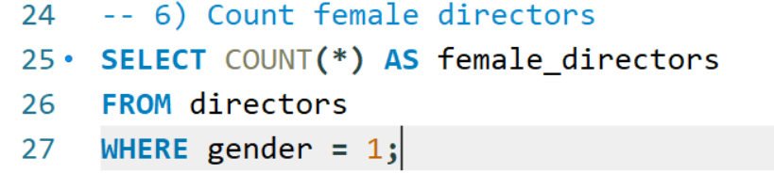
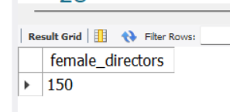
6. Count female directors
OUTPUT:-

Slide 14
6. Count female directors
Insight:
This query counts how many female directors are present in the dataset, enabling gender-based analysis.
Result Meaning:
Helps understand gender diversity among directors in the IMDB dataset.

Slide 15
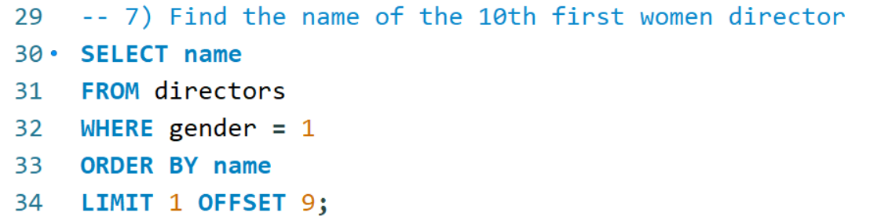
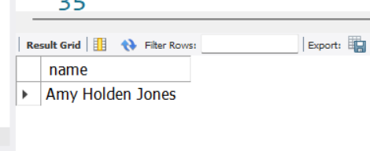
7. Find the name of the 10th first women director
OUTPUT:-

Slide 16
7. Find the name of the 10th first women director
Insight:
This query lists female directors alphabetically and retrieves the 10th entry, showing ordered data access.
Result Meaning:
Demonstrates use of ORDER BY and OFFSET for positional data retrieval.

Slide 17
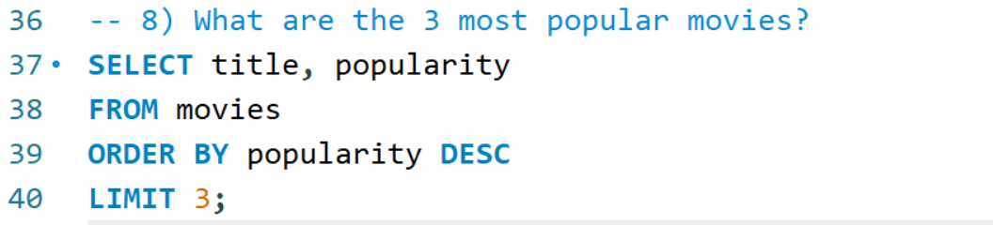
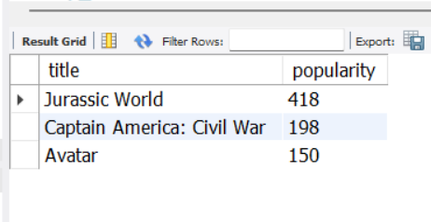
8. What are the 3 most popular movies?
OUTPUT:-

Slide 18
8. What are the 3 most popular movies?
Insight:
This query identifies movies with the highest popularity scores, indicating audience interest and visibility.
Result Meaning:
Popular movies often reflect strong audience engagement and widespread recognition.

Slide 19
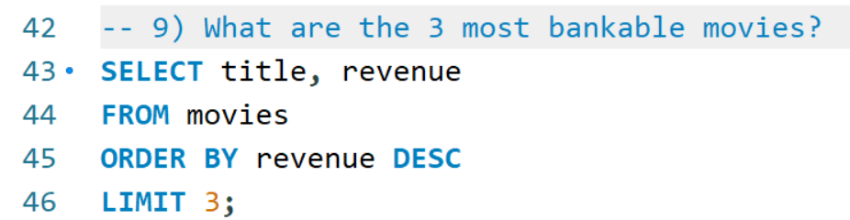
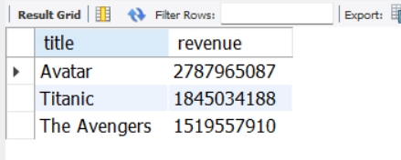
9. What are the 3 most bankable movies?
OUTPUT:-

Slide 20
9. What are the 3 most bankable movies?
Insight:
Bankable movies are identified using revenue, showing which movies earned the most money.
Result Meaning:
High revenue indicates commercial success regardless of critical ratings.

Slide 21
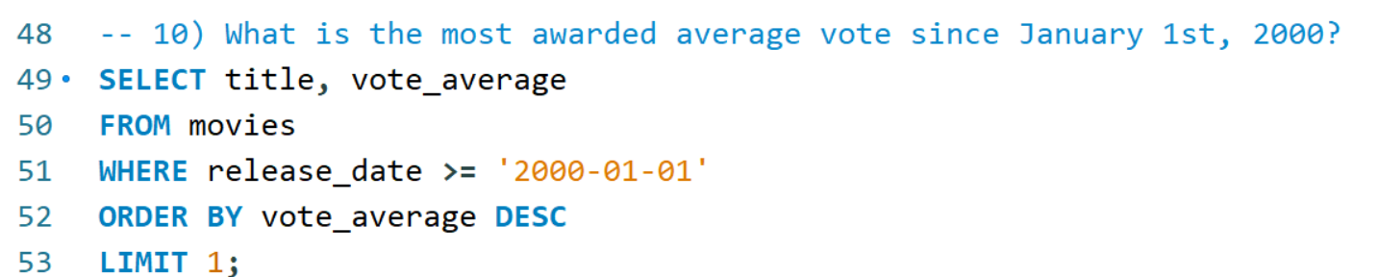
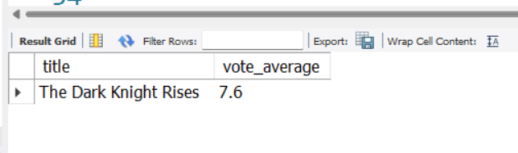
10. What is the most awarded average vote since January 1st, 2000?
OUTPUT:-

Slide 22
10. What is the most awarded average vote since January 1st, 2000?
Insight:
This query finds the highest-rated movie released after 2000, focusing on quality and audience appreciation.
Result Meaning:
Shows which modern movie received the best average audience rating.

Slide 23
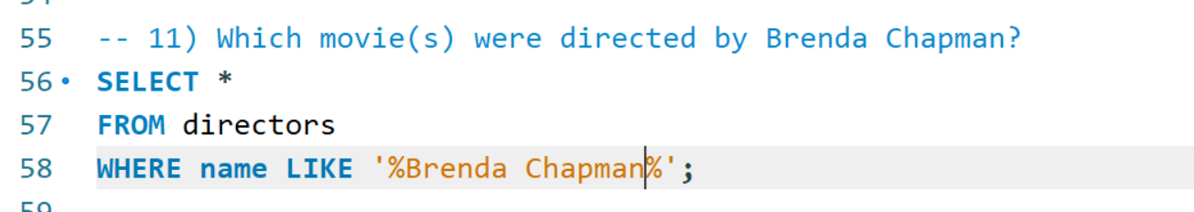
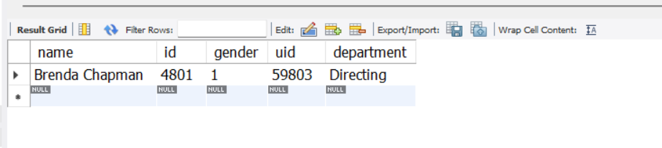
11) Which movie(s) were directed by Brenda Chapman?
OUTPUT:-

Slide 24
11. Which movie(s) were directed by Brenda Chapman?
Insight:
The query checks whether any movies in the dataset are associated with Brenda Chapman.
Result Meaning (Important):
No movies are linked to Brenda Chapman in this dataset.
Final Insight Statement:
This indicates that either her movies are not included or director-movie mapping is missing in the dataset.

Slide 25
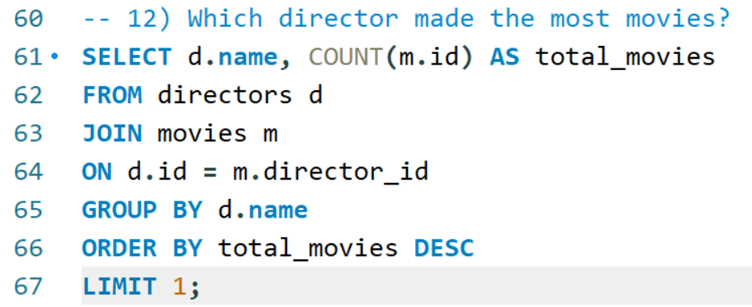
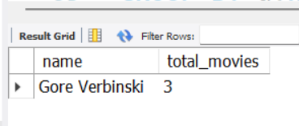
12. Which director made the most movies?
OUTPUT:-

Slide 26
Which director made the most movies?
Insight:
This query counts movies per director and finds the one with the highest count.
Result Meaning:
Identifies the most prolific director in the dataset.

Slide 27
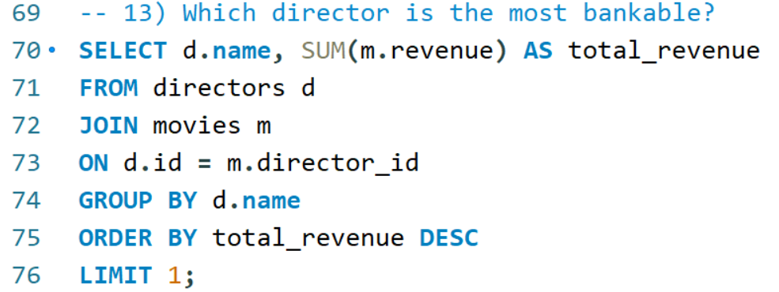
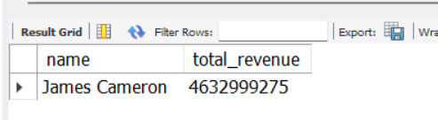
13. Which director is the most bankable?
OUTPUT:-

Slide 28
13. Which director is the most bankable?
Insight:
This query sums total revenue for each director and identifies who generated the highest earnings.
Result Meaning:
The most bankable director is the one whose movies collectively earned the most revenue, indicating strong commercial impact.

Slide 29
Thank you

